Slide 1




Test Cases, Test Scenarios and Test Execution
QA
Fundamentals
Ivan Yonkov
Technical Trainer
http://github.com/RoYaLBG
Software University
http://softuni.bg

Slide 2

Table of Contents
Test Plan
Test Coverage
Test Methods
Test Responsibilities
Test Cases
Test Scenarios
Test Execution

Slide 3

Test Plan

Slide 4
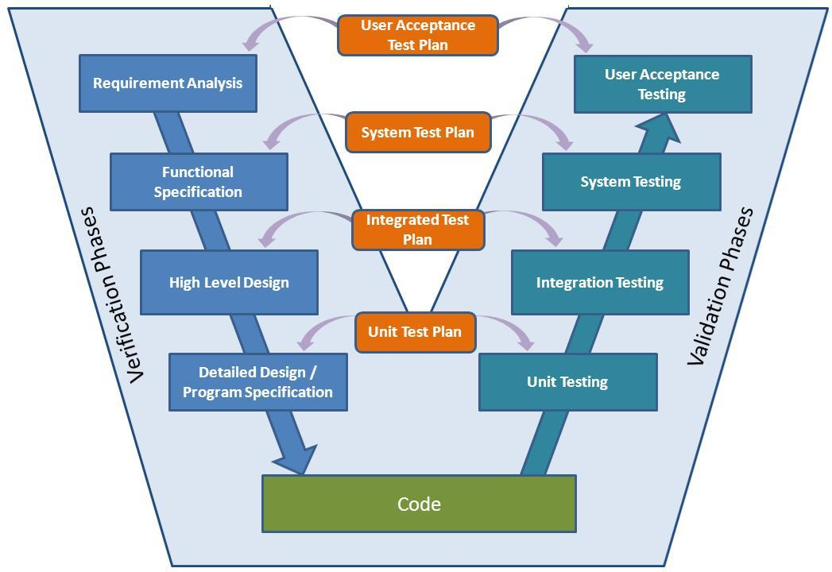

Slide 5

Test Plan
Documents the verification strategy
Strategy may vary on
Design verification or Complience test
Manufactoring or Production test
Acceptance or Commissioning test
Service and repair test
Regression test

Slide 6

Test Plan (2)
Three major elements should be described
Test coverage
Test methods
Test responsibilities

Slide 7
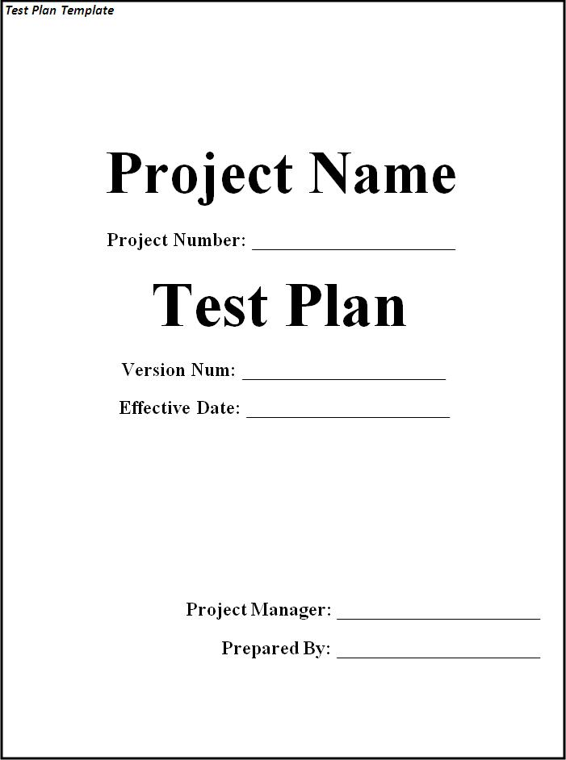
Test Plan (3)
Test plans usually are written with templates
Example test plan

Slide 8

Test Case

Slide 9
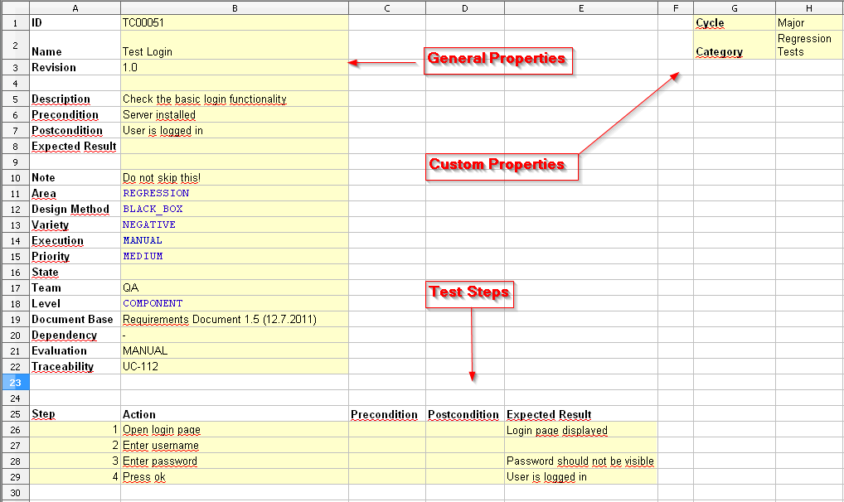
Test Case
Sequence of steps to check the correct behavior
At least two cases to fully test a requirement
A positive test
A negative test
Consist of
Steps to follow
Expected result

Slide 10
Test Case (2)
Additionaly may consist of
ID
Description
Related requirements
Depth
Test category
Author
Is automated
Pass/fail

Slide 11
Test Case (3)
Example test case
Step No: 1
Step description: Login to the app with user: “XXX” and password: “YYY”
Expected result: Home page is displayed
Step No: 2
Step description: Click “Logout”
Expected result: Login page is displayed

Slide 12
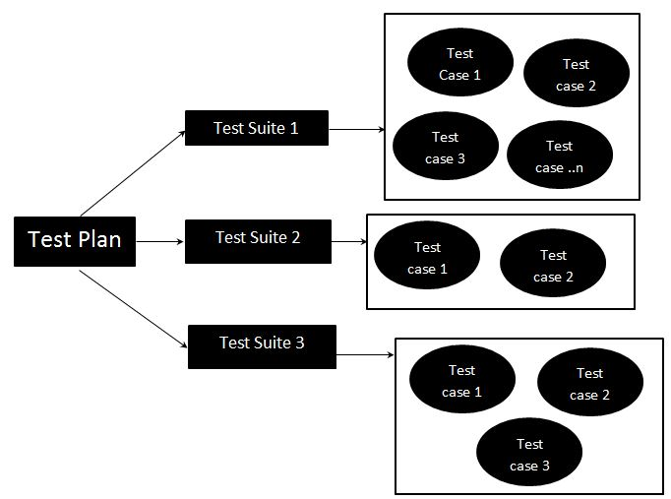
Test Case (4)
Test cases can be part of a Test suite
Test suite is a group of similar Test cases
Login functionality test cases leads to Login test suite
Test suites can be
Abstract test suites
Executable test suites

Slide 13

Test scenario

Slide 14
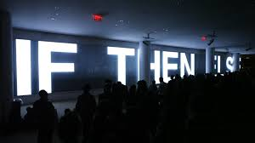
Test scenario
A scenario describes how a system is used in context of activity in a defined time-frame
Provides overview of
What to be tested
In which conditions

Slide 15
Test Scenario (2)
Test cases vs. test scenarios
Test scenario: Verify that device automatically connects to Wi-Fi if user creates new profile
Test cases:
Test case 1: Create Wi-Fi profile and verify that it created successfully
Test case 2: Verify that device is able to connect to Wi-Fi

Slide 16
Test scenario (3)
Test scenario examples
User should have an option to get his username/password back in case he has forgotten the same
User should have an option to sell items in any currency one wants to

Slide 17

Test Execution

Slide 18
Test Execution
Test execution is the process of executing the code and comparing the expected and actual results.
Test execution process factors
Test suites to be executed in that cycle
Assigning test cases to respective testers
Resolve blocking issues as they arise

Slide 19
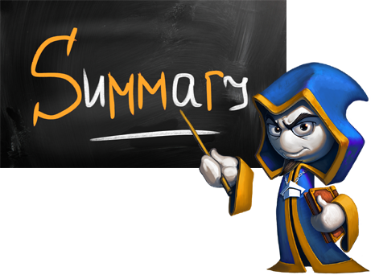
Summary
The V-Model
Test plan
Writing test cases
Bundling cases into a suite
Test execution

Slide 20









Test cases, test scenarios and test execution
http://softuni.org/courses

Slide 21
License
This course (slides, examples, demos, videos, homework, etc.) is licensed under the "Creative Commons Attribution-NonCommercial-ShareAlike 4.0 International" license
Attribution: this work may contain portions from
"Fundamentals of Computer Programming with C#" book by Svetlin Nakov & Co. under CC-BY-SA license
"C# Part I" course by Telerik Academy under CC-BY-NC-SA license

Slide 22





Free Trainings @ Software University
Software University Foundation – softuni.org
Software University – High-Quality Education, Profession and Job for Software Developers
softuni.bg
Software University @ Facebook
facebook.com/SoftwareUniversity
Software University @ YouTube
youtube.com/SoftwareUniversity
Software University Forums – forum.softuni.bg

